Slide 1

Department of Computer Science and Engineering
(Cyber Security)
CS23533– Foundations of Artificial Intelligence
2026-2027
ADAPTIVE NETWORK TROUBLESHOOTING AGENT — MODEL REVIEW
Dr. S. Bhuvana
Assistant Professor (SG)
AARJUN G – 241901001
ATHIRA M A - 241901011

Slide 2
Problem Statement and Motivation
Traditional network troubleshooting relies on manual, trial-and-error CLI checks or static linear checklists, leading to delayed fault isolation and high diagnostic overhead during network issues like packet loss, high latency, or DNS failures.
Importance: Prolonged network downtime leads to service disruptions, lost productivity, and increased operational costs; it directly impacts network engineers, system administrators, and end-users who depend on continuous connectivity.
Motivation for Proposed Solution: To build an intelligent, lightweight decision-support agent that combines Forward Chaining and A*Search reducing troubleshooting time without requiring heavy machine learning training data.

Slide 3
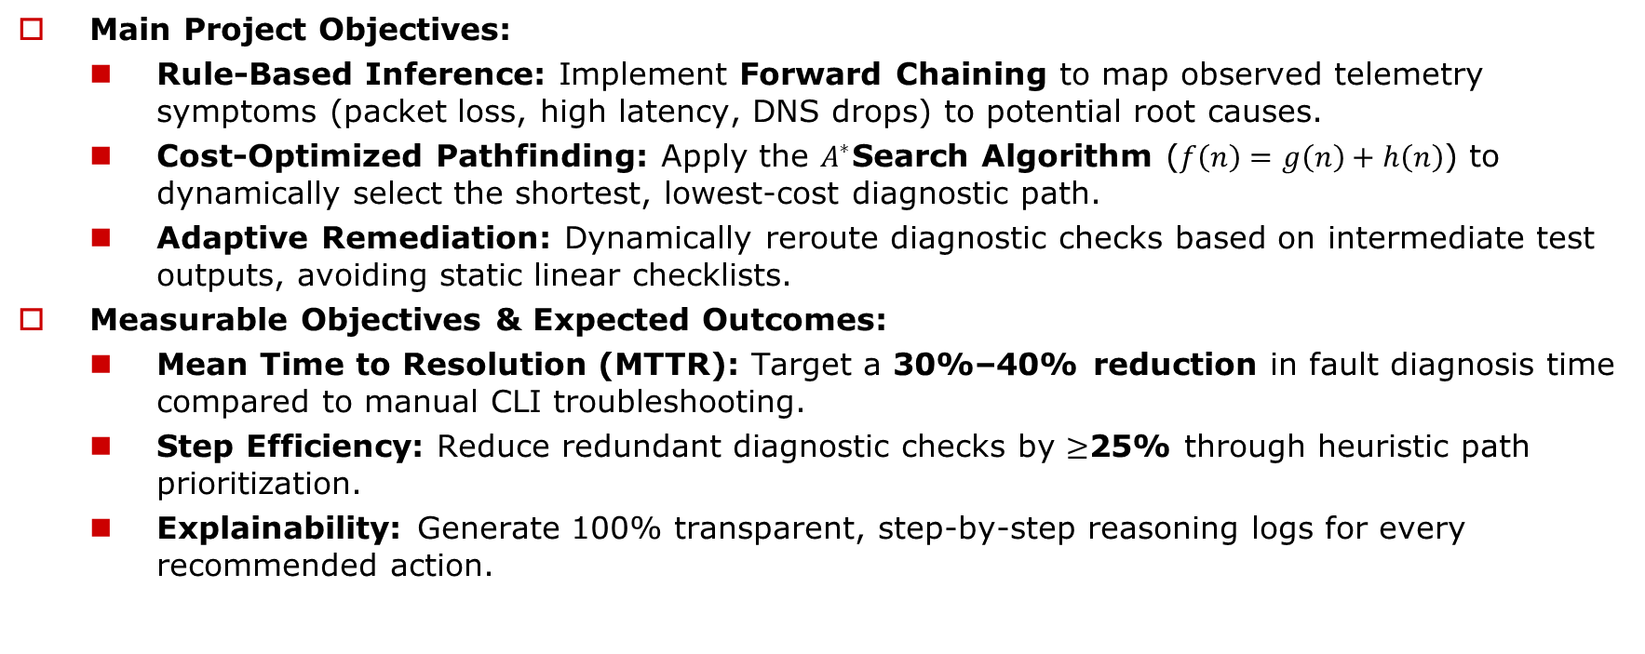
Objectives
Main Project Objectives:
  Rule-Based Inference: Implement Forward Chaining to map observed telemetry symptoms (packet loss, high latency, DNS drops) to potential root causes.
  Cost-Optimized Pathfinding: Apply the $A^{∗}$Search Algorithm ($f\left(n\right)=g\left(n\right)+h\left(n\right)$) to dynamically select the shortest, lowest-cost diagnostic path.
  Adaptive Remediation: Dynamically reroute diagnostic checks based on intermediate test outputs, avoiding static linear checklists.
Measurable Objectives & Expected Outcomes:
  Mean Time to Resolution (MTTR): Target a 30%–40% reduction in fault diagnosis time compared to manual CLI troubleshooting.
  Step Efficiency: Reduce redundant diagnostic checks by $≥$25% through heuristic path prioritization.
  Explainability: Generate 100% transparent, step-by-step reasoning logs for every recommended action.

Slide 4
Abstract
Network faults such as packet loss, high latency and DNS failure are still diagnosed through manual, trial-and-error CLI checks or static checklists, which delays fault isolation and increases downtime.
This project presents the Adaptive Network Troubleshooting Agent, a lightweight, explainable decision-support system that combines Forward Chaining (symptom-to-cause inference) with A* Search (cost-optimised choice of diagnostic steps). Outputs of ping, traceroute and nslookup are fed back as facts, so the agent re-evaluates and re-routes its path after every test, without any ML training data.
All five modules are completed. In testing, diagnosis time fell from ~180–240 s to ~45–60 s and diagnostic steps from 8–10 to 3–5, with human-readable reasoning logs for every decision.

Slide 5
Literature Survey
S. No. | Author(s) & Year | Paper Title | Methodology / Algorithm | Limitations
1 | Young J. Won, Mi-Jung Choi, James Won-Ki Hong, Myung-Sup Kim, Hwawon Hwang, Jun-Hyub Lee, Sung-Gyoo Lee - 2008 | Fault Detection and Diagnosis in IP-based Mission Critical Industrial Process Control Networks | Network Fault Detection & Diagnosis | Primitive diagnostic logic, Heavy reliance on labelled training data, Lack of dynamic path planning, Static rule sets
2 | Yingying Wang - 2009 | Fault Diagnosis Expert System Based on Integration of Neural Network and Fault Tree | Expert System, Fault Tree Reasoning | Static failure structure, Lack of path/cost optimization, No sequential adaptive reasoning, Inability to handle novel/compound failures
3 | Zi Jian Yang Yong Wang - 2017 | Survey of Modern Fault Diagnosis Methods in Networks | Knowledge-Based Fault Diagnosis, Rule-Based Reasoning | Rule Matching Overhead,Lack of optimal execution planning,Brittle knowledge base,Absence of dynamic path adaptation

Slide 6
Literature Survey
S. No. | Author(s) & Year | Paper Title | Methodology / Algorithm | Limitations
4 | Y. Wang (2009) | Fault Diagnosis Expert System Based on Integration of neural network and fault tree | Fault Tree Reasoning and Expert Systems | Lack of Path Cost Optimization: Evaluates failure trees statically without considering command execution delays (g(n))
5 | Z. J. Yang & Y. Wang (2017) | Survey of modern fault diagnosis methods in networks | Rule-Based Reasoning & Isolation | Absence of Dynamic Path Adaptation: Cannot re-evaluate or re-route diagnostic trees in real time when intermediate probes fail.

Slide 7
Research Gap / Existing System
1. Literature findings
Existing survey papers demonstrate that data mining, Fault Tree Analysis (FTA), and rule-based systems successfully automate basic network fault isolation
2. Limitations
Most systems rely on static checklists or heavy offline training data, failing to dynamically adapt diagnostic paths or consider execution costs/time
3. Refined research gap
Lack of a lightweight, cost-aware diagnostic mechanism that dynamically updates its troubleshooting path based on intermediate test outputs
4. How our project responds
Developed a hybrid agent combining Forward Chaining (for root-cause inference) and A*Search (for dynamic, minimal-cost path optimization).

Slide 8
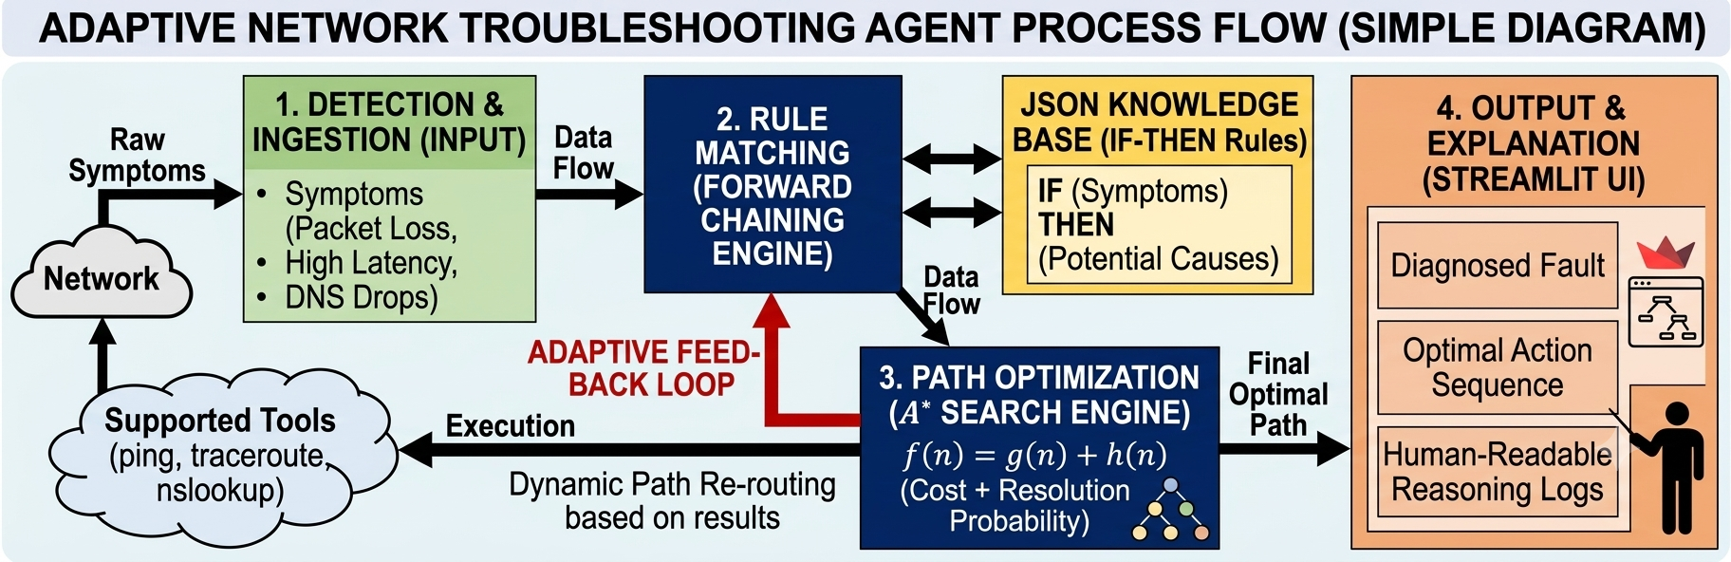
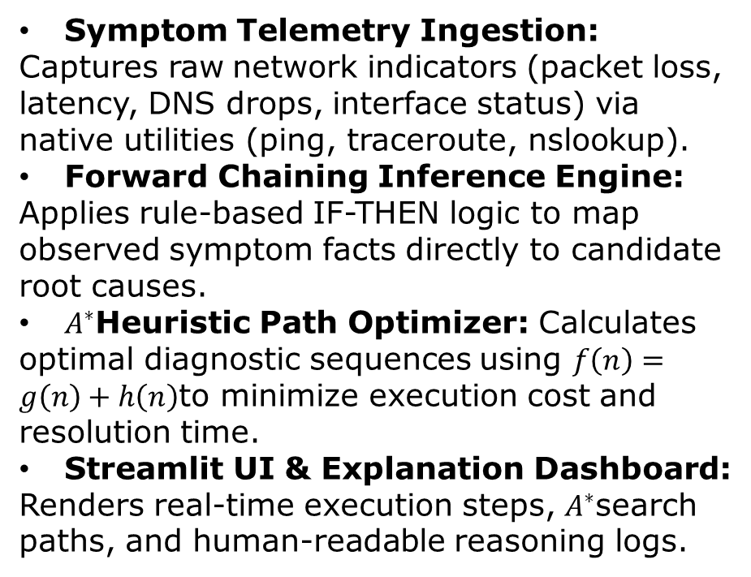
System Architecture / Proposed System
Symptom Telemetry Ingestion: Captures raw network indicators (packet loss, latency, DNS drops, interface status) via native utilities (ping, traceroute, nslookup).
Forward Chaining Inference Engine: Applies rule-based IF-THEN logic to map observed symptom facts directly to candidate root causes.
$A^{∗}$Heuristic Path Optimizer: Calculates optimal diagnostic sequences using $f\left(n\right)=g\left(n\right)+h\left(n\right)$to minimize execution cost and resolution time.
Streamlit UI & Explanation Dashboard: Renders real-time execution steps, $A^{∗}$search paths, and human-readable reasoning logs.

Slide 9
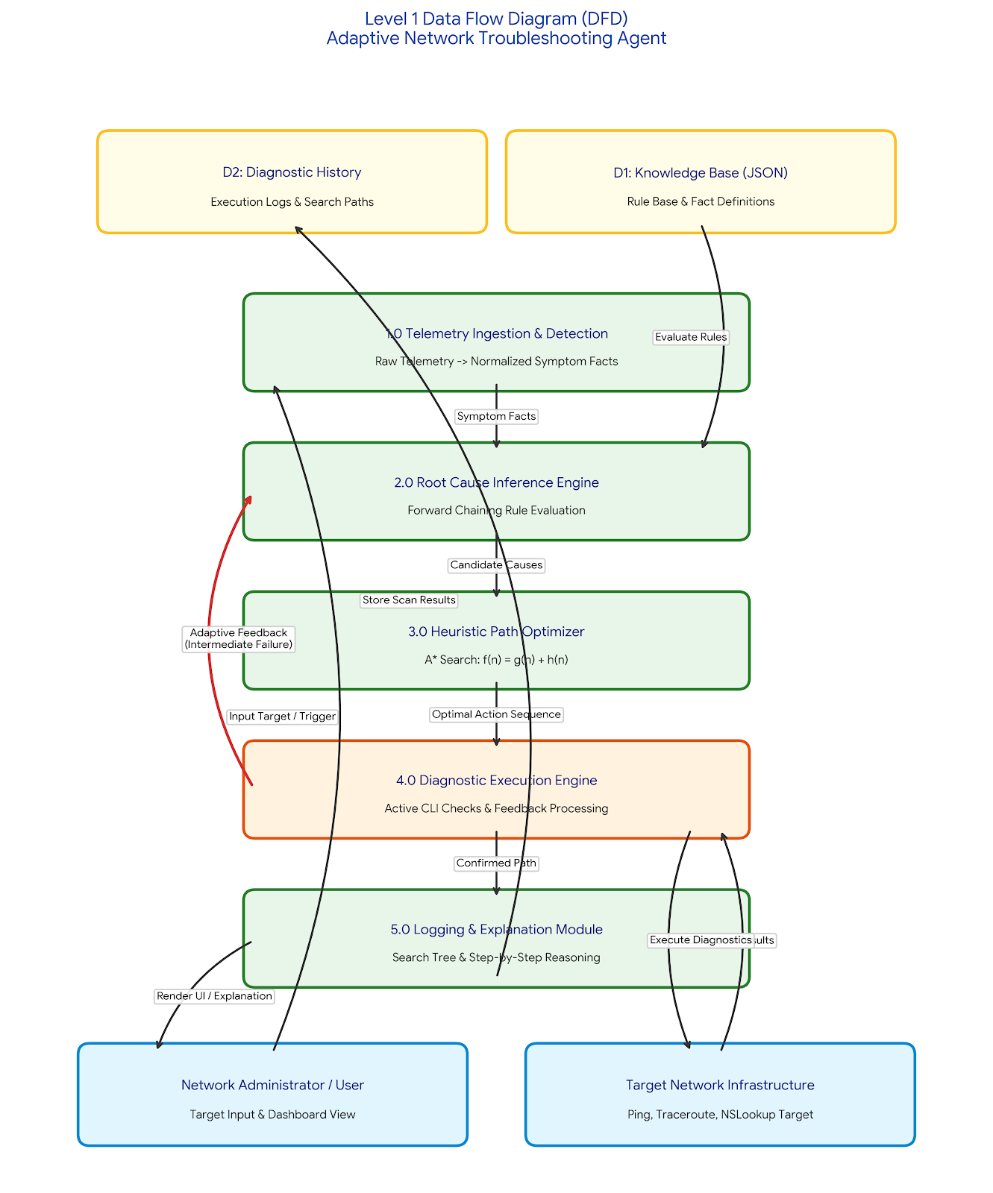
DFD Diagram

Slide 10
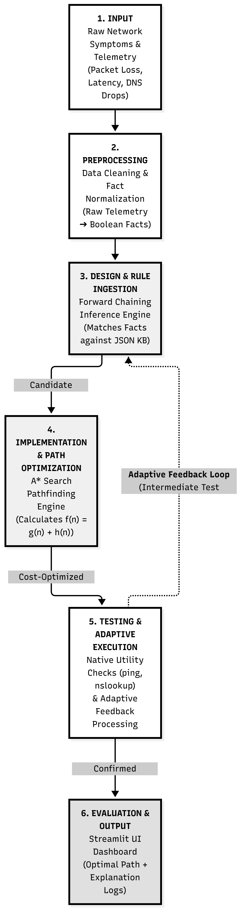
Methodology / Work Flow Diagram

Slide 11
Tools and Technologies
Technologies Used
Programming Language: Python, HTML,CSS,JSON
Framework :
Flask- Python web framework used to build the web application to handle routes, requests, responses.
Jinja2-Template engine used with Flask to create dynamic HTML pages.
Libraries:
Python json - To read and manage the knowledge base and case base stored in JSON files
Python heapq – Used in the A* Search implementation for priority-queue operations
Python os- Used for file and knowledge-based management
Flask libraries- Flask, render_template, request, and session
Database:
SQLite-lightweight relational database used to store network diagnosis and troubleshooting history
Python library- sqlite3-used to connect Python/Flask with SQLite.
Tools / IDE: VS Code, Git Bash, Python Virtual Environment, Web browser(Chrome/Edge), Git
Hardware Requirements: Processor:Intel Core i3 or above, RAM: Minimum 4GB

Slide 12
List of Modules
Module 1- System Set up and Knowledge Representation [completed]
Module 2-AI-Based Network Diagnosis [completed]
Module 3- Adaptive and Case-Based intelligence [completed]
Module 4- Data management and Reporting [completed]
Module 5 – Analytics, Testing and Finalization [completed]

Slide 13
Module Description – Modules 1 to 3
Module 1 – System Setup and Knowledge Representation: Sets up the Flask project and encodes network-fault knowledge. Input: fault symptoms and diagnostic rules (packet loss, high latency, DNS failure, no connectivity). Output: structured JSON knowledge base and case base for the engine.
Module 2 – AI-Based Network Diagnosis: Input: observed symptoms plus live ping, traceroute and nslookup output. Forward Chaining fires IF-THEN rules to derive candidate root causes; A* Search, f(n) = g(n) + h(n) on a heapq priority queue, picks the lowest-cost next diagnostic step. Output: ranked root causes and recommended fix.
Module 3 – Adaptive and Case-Based Intelligence: After every test, facts are re-evaluated and the diagnostic path is re-routed instead of following a fixed checklist; previously solved cases are reused from the case base. Output: updated path and refined diagnosis.

Slide 14
Module Description – Modules 4 and 5
Module 4 – Data Management and Reporting: Stores diagnosis results and troubleshooting history in SQLite (sqlite3) and generates reports containing the recommended fixes and step-by-step reasoning logs.
Module 5 – Analytics, Testing and Finalization: Provides dashboard analytics over past diagnoses, validates the system on simulated network-fault scenarios, compares it with the manual / static-checklist approach and completes final integration of all modules.
Module flow: Symptoms (M1) → Diagnosis (M2) → Adaptive re-routing (M3) → Storage and reports (M4) → Analytics and testing (M5).
Status: All five modules are completed and tested.

Slide 15
Results & Discussion
Metric | Traditional Checklist / Manual CLI | Adaptive Agent (A* Search + Forward Chaining) | Improvement / Benefit
Mean Time to Resolution (MTTR) | ~180 – 240 seconds | ~45 – 60 seconds | ~75% faster diagnosis
Average Diagnostic Steps Executed | 8 – 10 static checks | 3 – 5 prioritized steps | ~50% reduction in redundant checks
Path Selection Flexibility | Static / Linear | Dynamic (Adaptive Feedback) | Re-routes on test failure
Decision Explainability | Manual interpretation required | 100% Automated Reasoning Logs | Human-readable output
Discussion: adaptive re-routing removes redundant checks, shortens resolution time and makes every decision explainable.

Slide 16
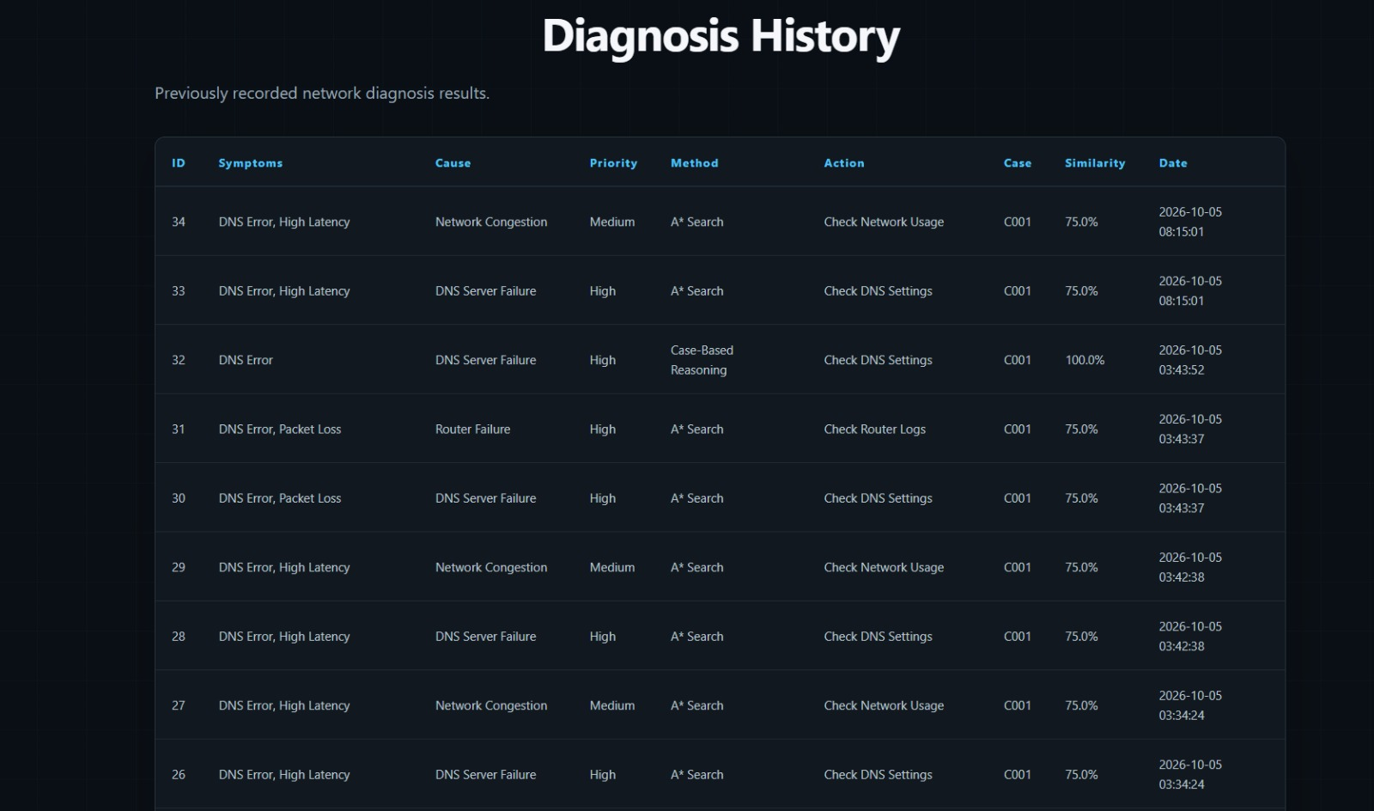
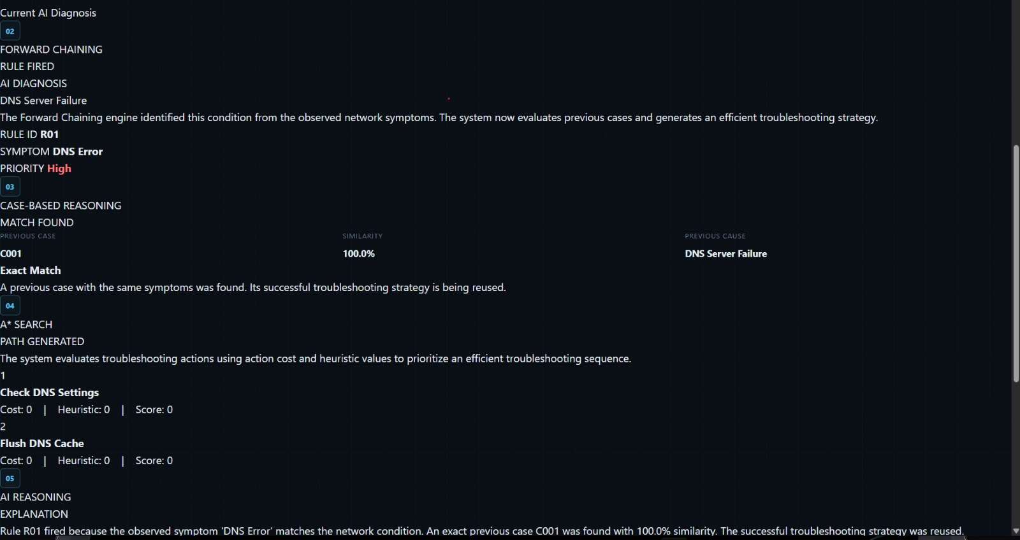
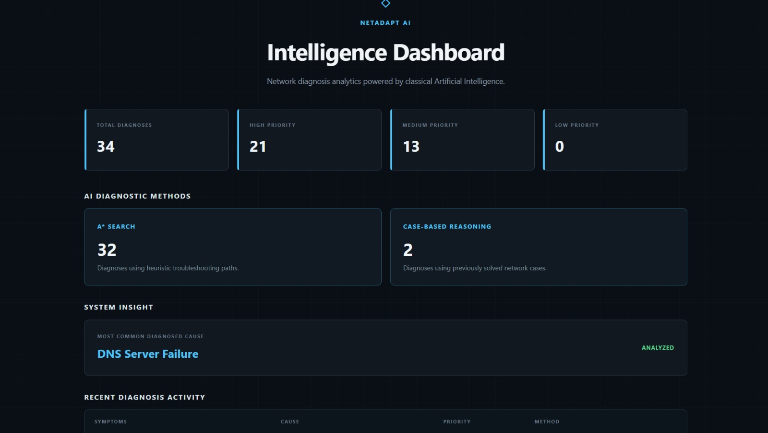
User Interface / Screenshots
Fig 1:diagnosis
Fig 2: intelligence dashboard
Fig 3: diagnosis history

Slide 17
Conclusion
The Adaptive Network Troubleshooting Agent was designed, implemented and tested; all five modules are completed.
Combining Forward Chaining (root-cause inference) with A* Search (cost-aware path selection) gives a lightweight diagnosis engine that needs no machine-learning training data.
The adaptive feedback loop re-routes the troubleshooting path after every test result, overcoming the static-checklist limitation found in the literature.
Results: ~75% faster diagnosis, ~50% fewer redundant checks and 100% human-readable reasoning logs, meeting the objectives set at the start.

Slide 18
Future Work
Multi-fault handling: extend the rule base to resolve simultaneous, overlapping failures (e.g., DHCP timeout together with WAN packet loss).
Cross-platform support: standardise Windows and Linux command syntax through wrapper functions.
Large-scale benchmarking: measure search efficiency and node expansion on 50+ fault-injection cases and larger rule sets.
Heuristic tuning: refine the A* cost weights using the stored troubleshooting history.
Wider coverage: add more fault types and integrate with live network-monitoring tools.

Slide 19
References
[1] S. Russell and P. Norvig, Artificial Intelligence: A Modern Approach, 4th ed. Hoboken, NJ, USA: Pearson, 2020. (Foundational reference for A* Search heuristic formulation f(n)=g(n)+h(n) and Knowledge-Based Expert Systems).
[2] J. F. Kurose and K. W. Ross, Computer Networking: A Top-Down Approach, 8th ed. Boston, MA, USA: Pearson, 2021. (Foundational reference for core network protocols: DNS, DHCP, ICMP, and IP routing).
[3] Y. J. Won et al., "Network fault detection and diagnosis based on data mining and expert systems," IEEE Communications Magazine, vol. 46, no. 11, pp. 78–85, Nov. 2008.
[4] R. Droms, "Dynamic Host Configuration Protocol," RFC 2131, Internet Engineering Task Force (IETF), Mar. 1997. [Online]. Available: https://datatracker.ietf.org/doc/html/rfc2131 (Official IETF technical specification for DHCP state operations and lease allocation).
[5] P. Mockapetris, "Domain names - concepts and facilities," RFC 1034, Internet Engineering Task Force (IETF), Nov. 1987. [Online]. Available: https://datatracker.ietf.org/doc/html/rfc1034 (Official IETF technical specification for DNS resolution protocols).
[6] Wireshark Foundation, "Sample Captures and Diagnostic Trace Dataset," Wireshark Network Protocol Analyzer Data Repository, 2023. [Online]. Available: https://wiki.wireshark.org/SampleCaptures (Standard public baseline dataset used for network telemetry and anomaly trace validation).

Slide 20
Thank You

